Slide 1
A Deep Learning-Based Approach for
Tumor Detection
BY - Pavan kalyan, Bhuvan, Siddique

Slide 2
Abstract:
Tumor segmentation is one of the most critical and challenging challenges in the realm of
medical image processing due to the risk of incorrect prediction and diagnosis when using
human-aided hand categorization for cancer cell identification.
It is difficult to distinguish tumor areas from pictures because tumors have a diverse
appearance and superficially resemble normal tissues.
Deep learning techniques applied to a greater number of pictures were used in the
development of the model that we used in this study to identify and remove tumors found
on 2D MRI scans of the brain.

Slide 3
Introduction :
In this experiment, a real-time dataset was used, and inside it were numerous tumors of varied sizes,
locations, forms, and picture intensities.
The Convolutional Neural Networks (CNNs) are much more efficient than the traditional classifiers like
SVM, Random Forest.
In order to arrive at an appropriate diagnosis for a patient, physicians often make use of various forms of
medical imaging to examine what is taking on within the body of the patient and it might be difficult to spot
tumors in medical images.
More than a million individuals are found to have tumors in the course of each year, so we need a proper
diagnosis for it

Slide 4
Convolutional Neural Network:
CNN is an example of an artificial neural network, often known as a multilayered sensor. Its architecture is
inspired on the structure of the visual cortex. One of the most important ideas behind deep learning is
convolutional neural network, or CNN. CNN consists of two basic processes, which are referred to as
convolution and pooling, and is often used in applications that are related to image recognition.
These designs minimize the amount of traceable parameters while allowing for the learning of a
variety of network properties. CNN, in contrast to more traditional methods, may learn to
completely extract features
while simultaneously performing a reduced number of specialized duties.

Slide 5
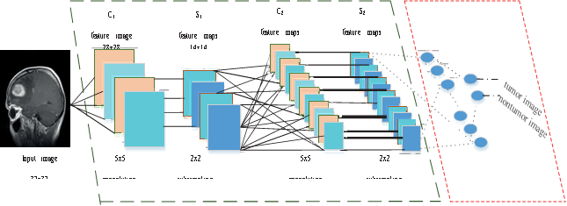
C-NN LAYERS
Layers

Slide 6
Background of tumor detection
Preprocessing: Noise may affect MR images. Picture compression and data transfer may produce noise.
Nonlocal techniques and local smoothing were used to reduce noise [19,28]. Some significant
visual structures and features might appear as if they were made of noise; these vital details
may also be deleted.
Figure 4 shows axial, coronal, and sagittal MR images. Figures 2a and 2b show an original and
preprocessed image.

Slide 7
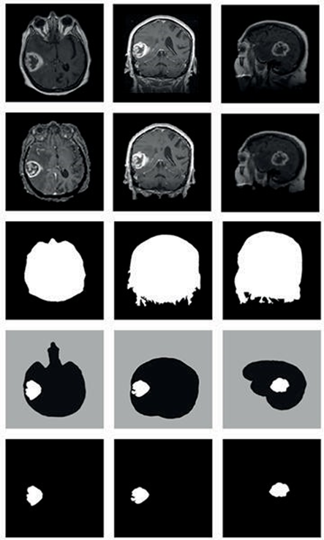
Different types of image extracted
Pre-processing of images

Slide 8
PROPOSED WORK:
In those proposed model designed 5 layer CNN which is used for early identification of tumors.
The combined model, with its seven steps (eight if you include the hidden layers), yields the
best results for tumor detection. We have broken down the process into seven steps from which
a brain tumor may be detected
utilizing CNN. Step-by step instructions (shown in Figure 3) reveal the process. In Fig. 4, we can
see the proposed method for tumor detection using a 5-Layer Convolutional Neural Network.
Five discrete dimensions are shown in Figure 4

Slide 9
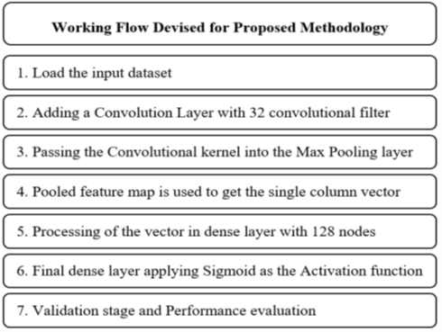
WOrking Flow ofC-NN

Slide 10
Convolutional Layer:
Convolutional layer is CNN's backbone. First, a convolutional layer is used to resize MRI images.
This makes 64*64*3 input shape. After gathering all same-orientation photos, we developed a
convolutional kernel using 32 3*3 convolutional filters and 3 channel tensors. The activation
function is ReLU. The filter size is three times the 64x64x3 input volume. Each neuron in the
convolutional layer has 3*3*3 = 27 weights, plus one for the bias parameter.

Slide 11
Max Pooling Layer
The fundamental objective of the pooling layer is to reduce the number of parameters and
computation workloads in the network by progressively decreasing the spatial size of the
representation. Over-fitting may be managed thanks to its ability to scale down the settings.
MaxPooling2D was used as the input image in the proposed model. There are a total of 32
nodes in this convolutional layer, resulting in a 31*31*31 matrix.

Slide 12
Flatten Layer:
Pooling creates a pooled feature map. The flatten layer is crucial after pooling because it
transforms the input picture matrix into a single column vector for processing. The neural
network processes it. Layer 31*31*32 = 30752 pixels

Slide 13
A Fully Connected Layer:
The dense-1 and dense-2 layers were totally linked. Keras processes the neural network using
the dense function, and the output vector is fed to this layer. Each layer has 128 nodes. Due of
high processing costs, we restricted the number of dimensions or nodes to 128.

Slide 14
EXPERIMENTAL RESULTS & EVALUATION:
Experimental Setup: Jupyter Notebook and Python technologies like Numpy, Pandas, OpenCV were used
for image processing. For classifiers, we used Scikit-Learn. Used Anaconda and Python 3.6. Our CNN model
was trained and tested using Tensorflow and Keras. We used Google Colab's GPU. Dataset Acquisition:
Br35H-Mask-RCNN dataset [16] is used to segment brain tumors. Cancers and non-tumors are labeled. A set
has two classes. Class-1 is tumors MRI while class-2 is non-tumors (class-0). Training is 700 and testing is 100.
24 images test performance. Performance Measures: To assess how well our model works, we must
consider performance matrices. We'll discuss our model's performance statistic in this section. We must learn
performance measurement lingo.

Slide 15
5.3.1 Confusion Matrix: TP: Number of correctly identified tumor photographs.
TN: is the number of correctly detected non-tumor images.
FP:The number of non-tumor images labeled tumor
FN: Number of tumor photographs mislabeled as non-tumor.
Accuracy: It's the most common way to measure how often a classifier is correct. Accuracy is the ratio of accurately predicted images to the total number of photos.
𝐴𝑐𝑐𝑢𝑟𝑎𝑐𝑦 = 𝑇𝑃+𝑇𝑁 𝑇𝑃+𝑇𝑁+𝐹𝑃+𝐹𝑁
Precision The model's data is retrieved. Precision is the ratio of correctly detected tumor images (TP) to
misclassified ones (TP+FP).

Slide 16
Precision rises with FP. A more accurate model is more effective. It’s the proportion of retrieved images.
𝑃𝑟𝑒𝑐𝑖𝑠𝑖𝑜𝑛 = 𝑇𝑃 𝑇𝑃 + 𝐹𝑃 (3) 5.3.4 Recall: Recall is the ratio of tumor photographs correctly detected to
images to be projected. It's also called sensitivity, hit rate, and true positive rate. Because non-tumor images
are rare, a smaller false negative increases memory.
𝑅𝑒𝑐𝑎𝑙𝑙 = 𝑇𝑃 𝑇𝑃 + 𝐹𝑁
F-Score
The harmonic mean of recall and precision is used as a measurement of test accuracy. F-scores range from 1 (perfect accuracy and recall) to 0 (zero).
𝐹 − 𝑆𝑐𝑜𝑟𝑒 = 2𝑇𝑃 2𝑇𝑃 + 𝐹𝑃 + 𝐹𝑁

Slide 17
CONCLUSION & FUTURE WORKS:
In this work, we analyzed automated tumor detection from MR imaging and CT images using hard and soft
computing. We utilized CNN to identify brain tumors using deep learning. Our study presents a broad
technique for identifying and analyzing tumors. Parallelizing and using a high-performance computing
platform for the complete dataset increases efficiency. We tried to precisely identify tumors; however some
were missed or misidentified. We'll work on the photos and the whole dataset. In the future, we will apply
other deep learning techniques to improve accuracy. Future opportunities to improve or examine our work
will arise. After identifying the tumor, we'll decide whether it's benign or malignant. Future deep learning
techniques may be modified.

